Slide 1
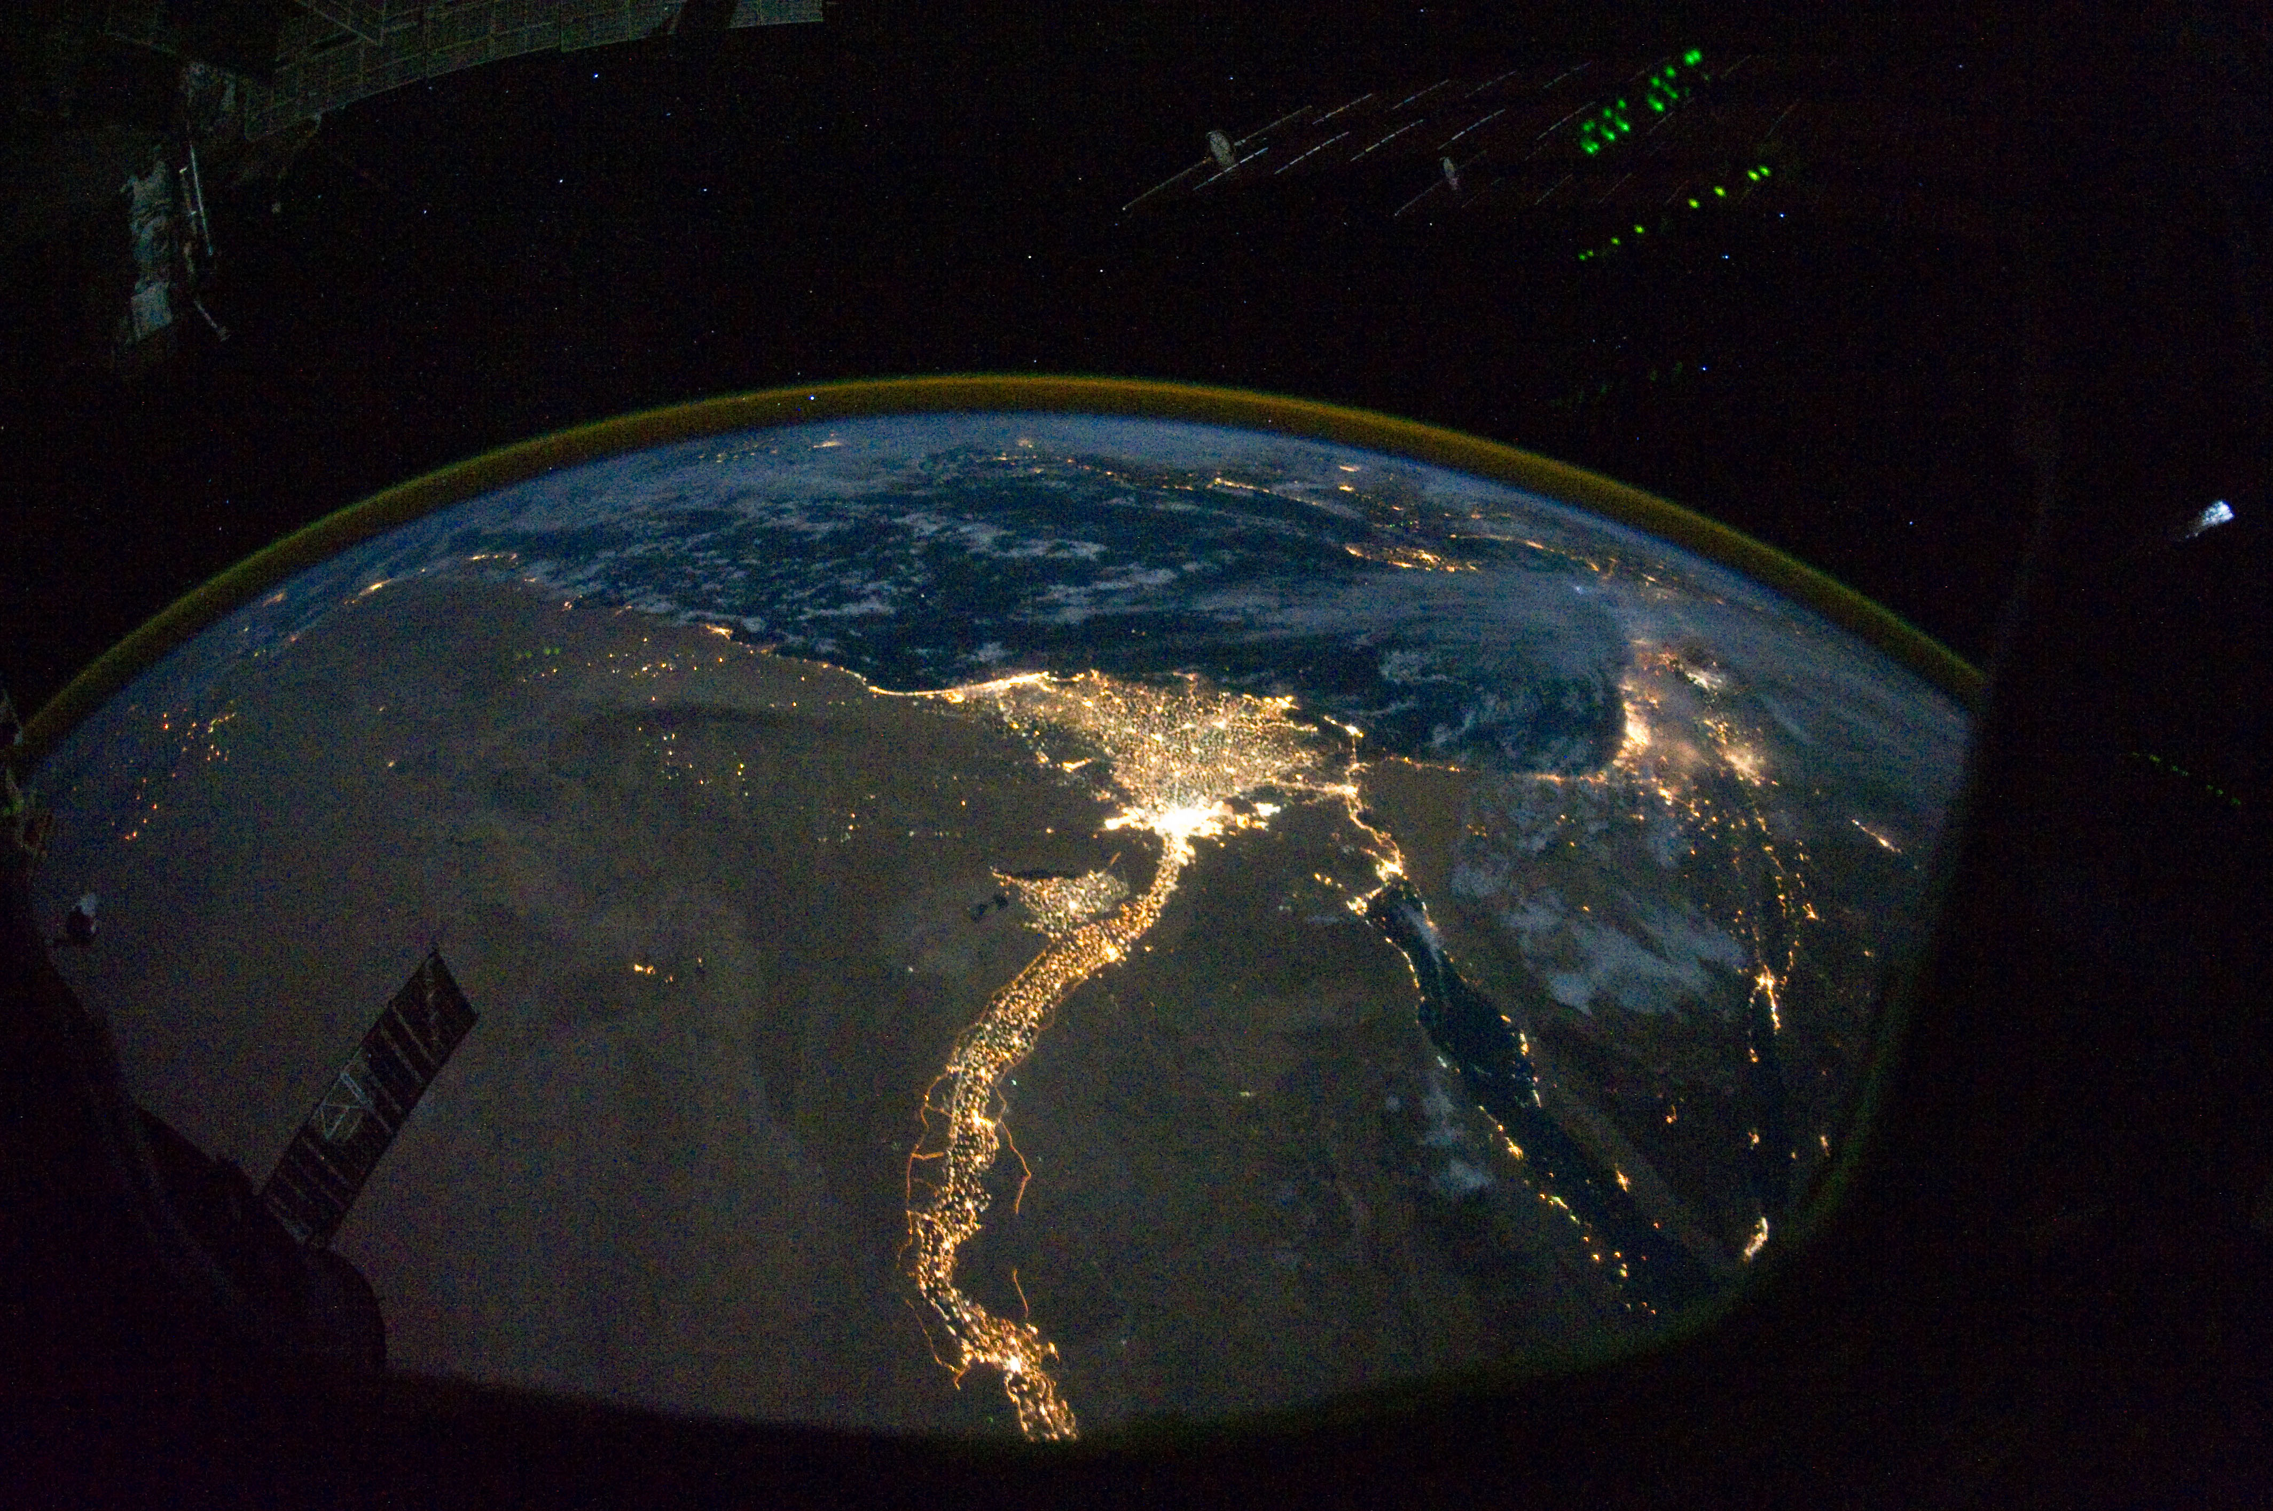
Land degradation
Ahmed Kabil Karim Ibrahim Randa negm Mohamed Ahmed Mohamed Alaa

Slide 2
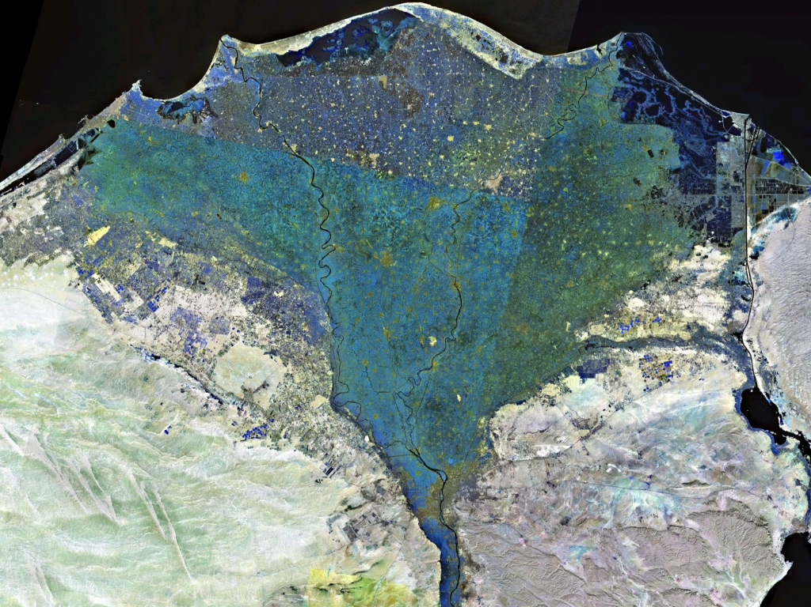
Land degradation is a process in which the value of the biophysical environment is affected by a combination of human-induced processes acting upon the land. It is viewed as any change or disturbance to the land perceived to be deleterious or undesirable.

Slide 3
Causes:
pollution, often chemical, due to agricultural, industrial, mining or commercial activities.
artificial radioactivity, sometimes accidental.
land-use constraints associated with armed conflicts.
loss of land due to urban construction.

Slide 4
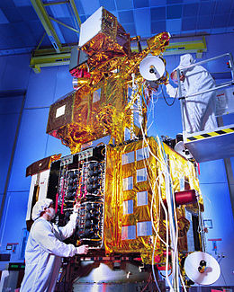
Landsat 7 was designed to last for five years, and has the capacity to collect and transmit up to 532 images per day. It is in a polar, sun-synchronous orbit, meaning it scans across the entire earth's surface. With an altitude of 705 kilometers +/- 5 kilometers, it takes 232 orbits, or 16 days, to do so.

Slide 5
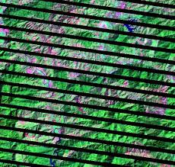
The problem was that in May 2003, the Scan Line Corrector (SLC) in the ETM+ instrument failed. Without the effects of the SLC, the instrument images the Earth in a "zig-zag" fashion, resulting in some areas that are imaged twice and others that are not imaged at all. The net effect is that approximately 22% of the data were lost

Slide 6
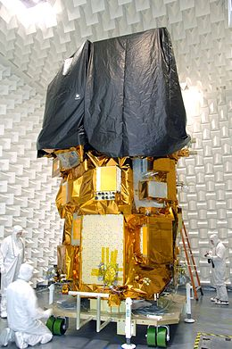
Landsat 8
Provides moderate-resolution imagery, from 15 meters to 100 meters, of Earth’s land surface and polar regions, operates in the visible, near-infrared, short wave infrared, and thermal infrared spectrums. Landsat 8 captures more than 700 scenes aday.

Slide 7
Choosing the image:
Cloud cover capture time Season Sensors

Slide 8
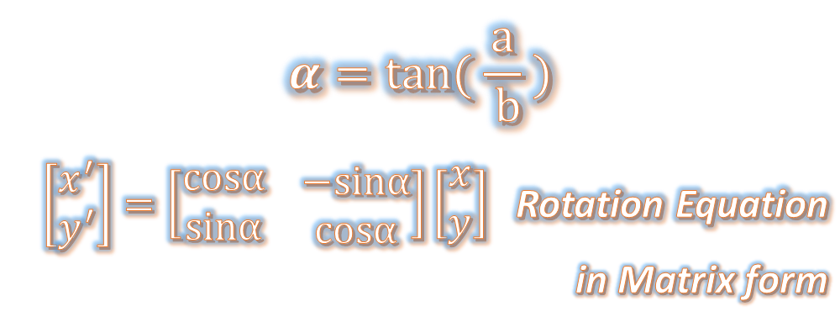
Geometric-correction:
is the process of digitally manipulating image data such that the image's projection precisely matches a specific projection surface or shape.
$$α=tan⁡( \frac{a}{ b} )$$
$\left[\begin{matrix}x^{′} \\ y^{′}\end{matrix}\right]=\left[\begin{matrix}cosα \\ sinα\end{matrix} \begin{matrix}−sinα \\ cosα\end{matrix}\right]\left[\begin{matrix}x \\ y\end{matrix}\right]$ Rotation Equation in Matrix form
x , y are the new image pixels coordinates and ( x' , y' ) original image pixels coordinates

Slide 9
Geometric-correction:
we rotate the coordinates of the new image to the original one then we store the Brightness value.
The reason is the opposite operation made blank pixels between the rotated pixels
Scanning the image is started from the sides to avoid lose the parts of the image outside the new frame.
The new frame has more enough size than the original.
There are the rounding and Transition issues.
The cropping of the blank pixels around the picture is the last step.

Slide 10
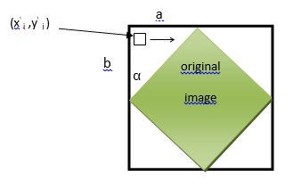
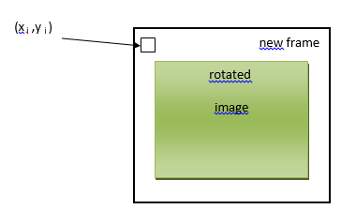
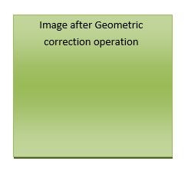
Geometric-correction:

Slide 11
Cropping
In order to get the desired Image to do the analysis on, We used the Lat and Long For the original image and the Lat and Long for the specific area we wanted

Slide 12
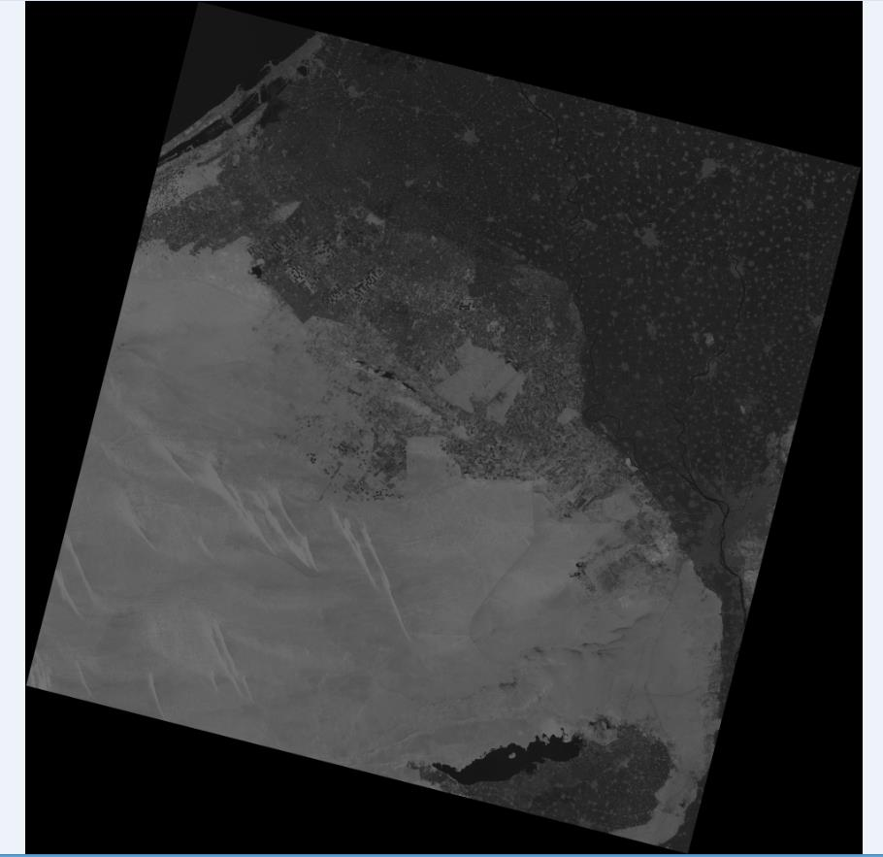
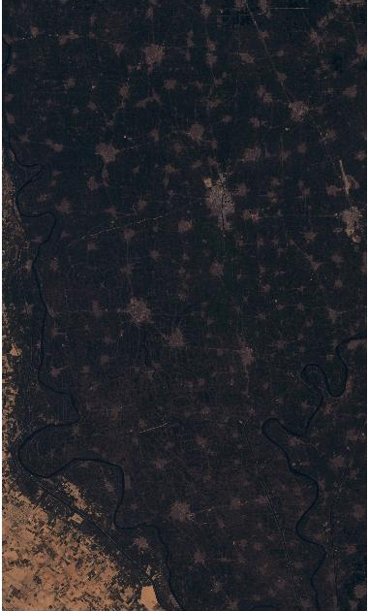

Slide 13
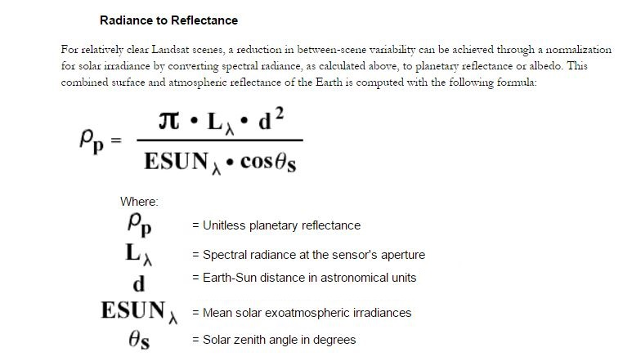
Atmospheric Correction: Landsat 7

Slide 14
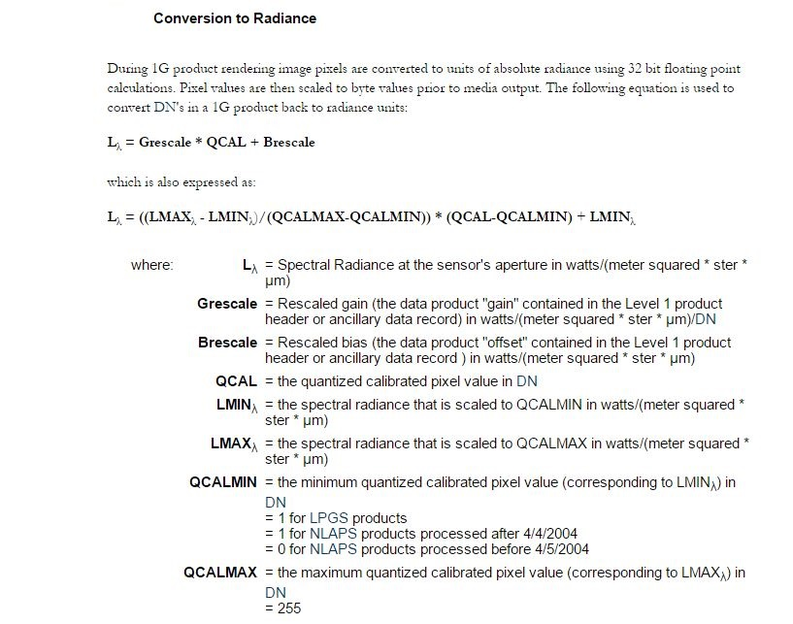
Atmospheric Correction: Landsat 7

Slide 15
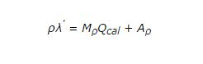
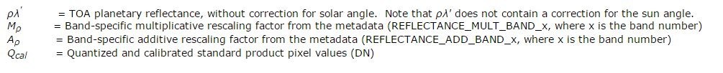
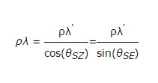
Atmospheric Correction: Landsat 8

Slide 16
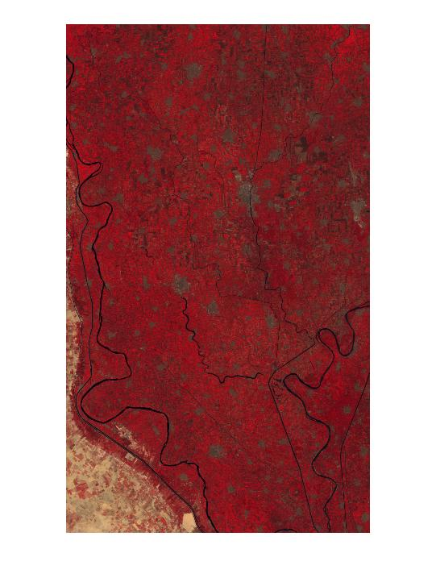
2003 Before Histogram Matching

Slide 17
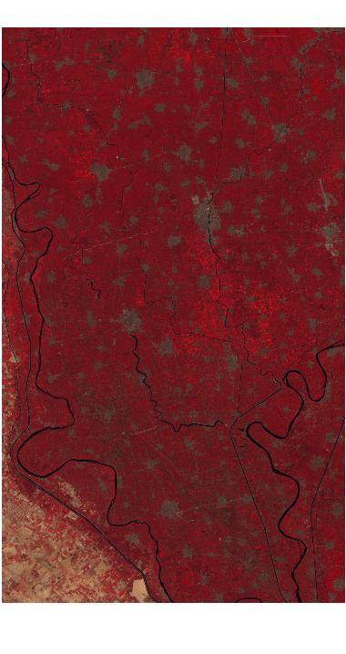
2015 Before Histogram Matching

Slide 18
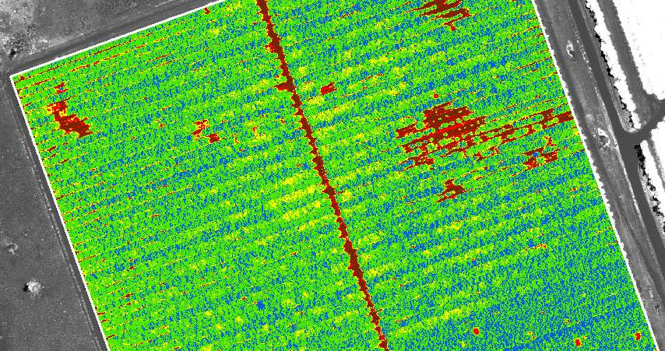
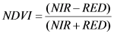
Methods of Classifications:
The Normalized Difference Vegetation Index (NDVI) is an index of plant “greenness” or photosynthetic activity, and is one of the most commonly used vegetation indices.
NDVI is calculated on a per-pixel basis as the normalized difference between the ratio of red and near infrared bands from a remotely-sensed image.

Slide 19
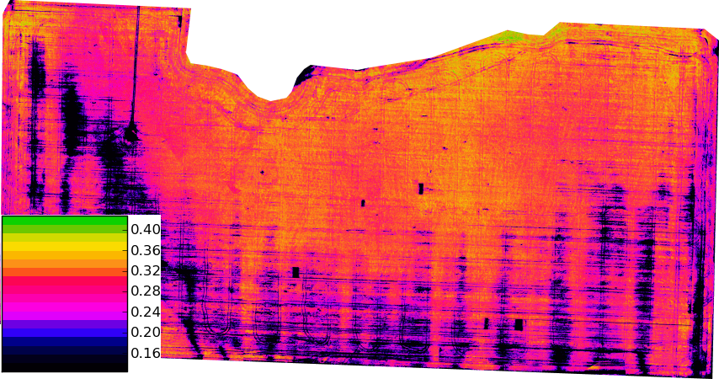
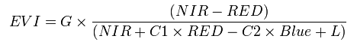
The enhanced vegetation index (EVI) is an 'optimized' index designed to enhance the vegetation signal with improved sensitivity in high biomass regions and improved vegetation monitoring through a de-coupling of the canopy background signal and a reduction in atmosphere influences.

Slide 20
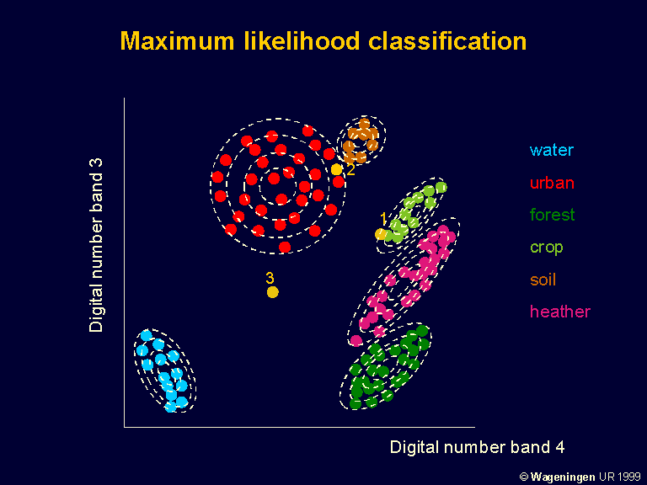
Maximum likelihood classification:
The maximum likelihood classifier is one of the most popular methods of classification in remote sensing, in which a pixel with the maximum likelihood is classified into the corresponding class. The likelihood is defined as the posterior probability of a pixel belonging to class k.

Slide 21
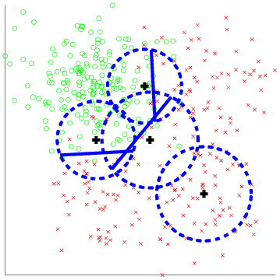
KNN
k-Nearest Neighbors algorithm is a non-parametric method used for classification and regression. In both cases, the input consists of the k closest training examples in the feature space. The output depends on whether k-NN is used for classification or regression

Slide 22

Principal component analysis (PCA) is a statistical procedure that uses an orthogonal transformation to convert a set of observations of possibly correlated variables into a set of values of linearly uncorrelated variables called principal components.
This method didn’t work in this project because PCA needs to detect some definite change in multiple bands and in some continuous area.

Slide 23
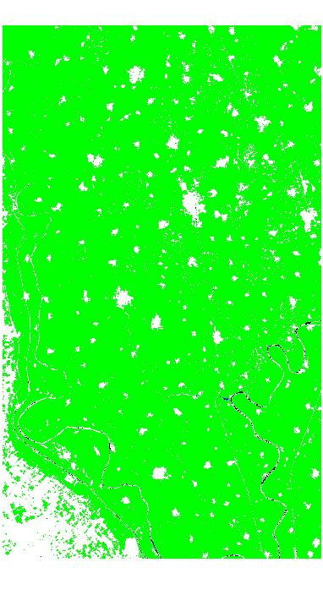
First Results:
2003 EVI Classification

Slide 24
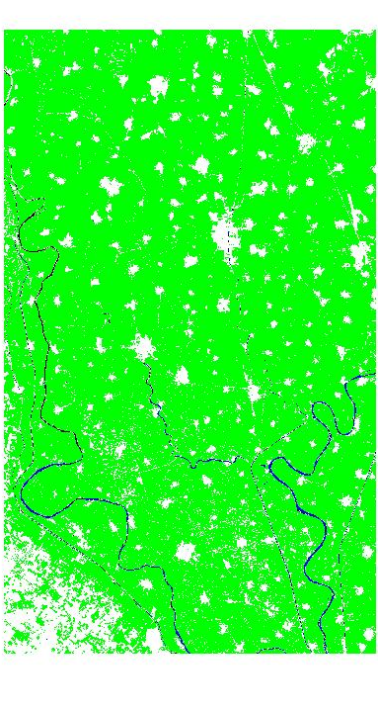
First Results:
2015 EVI Classification
55.8774 Km^2

Slide 25
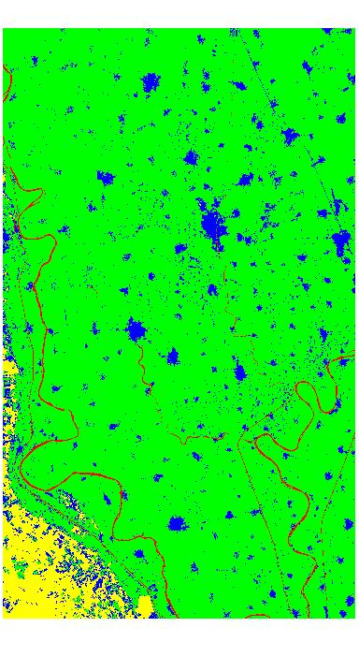
First Results:
2003 KNN Classification

Slide 26
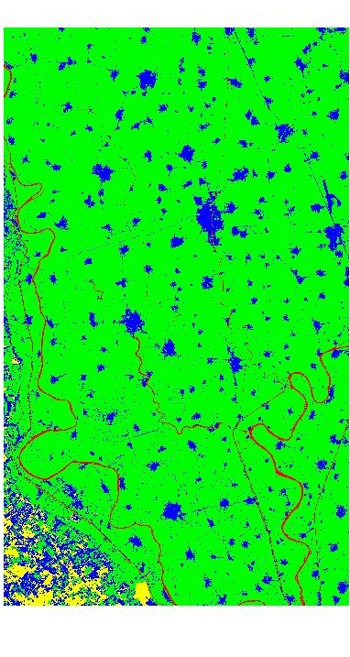
First Results:
2015 KNN Classification
20.9115Km^2

Slide 27
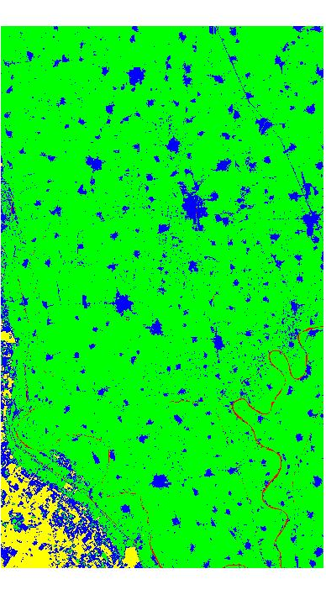
First Results:
2003 Maximum Likelihood

Slide 28
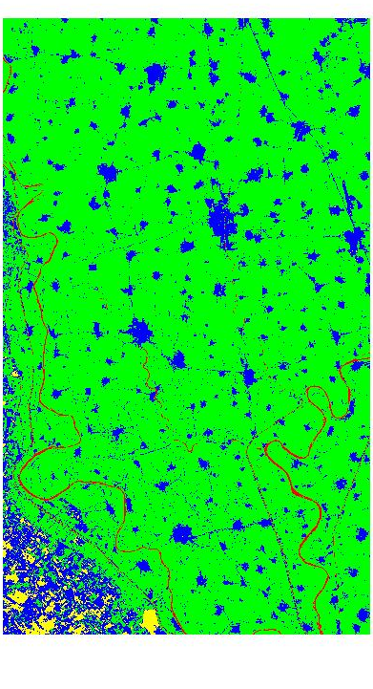
First Results:
2015 Maximum Likelihood
12.0330 Km^2

Slide 29

First Results:
2003 NDVI Classification

Slide 30
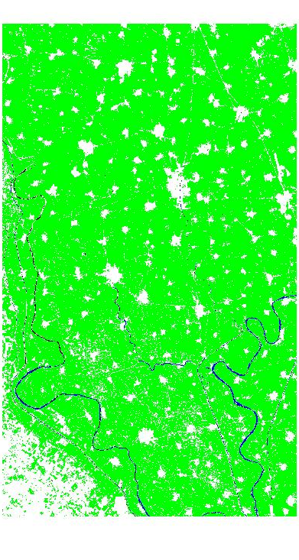
First Results:
2015 NDVI Classification
28.6821 Km^2

Slide 31
Final Results:
2003 after Histogram Matching

Slide 32
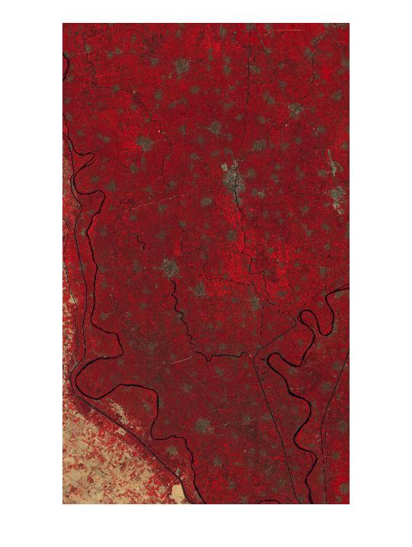
Final Results:
2015 after Histogram Matching

Slide 33
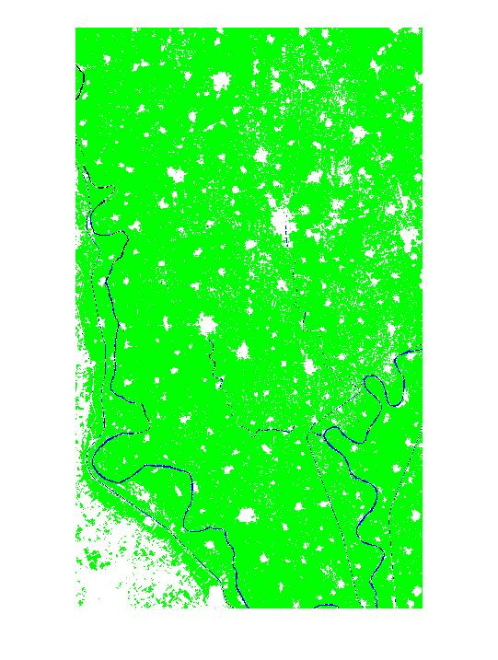
Final Results:
2003 EVI Classification

Slide 34
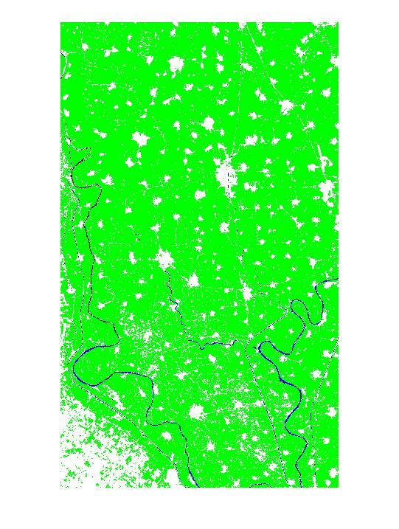
Final Results:
2015 EVI Classification
35.6310 Km^2
1.85%

Slide 35
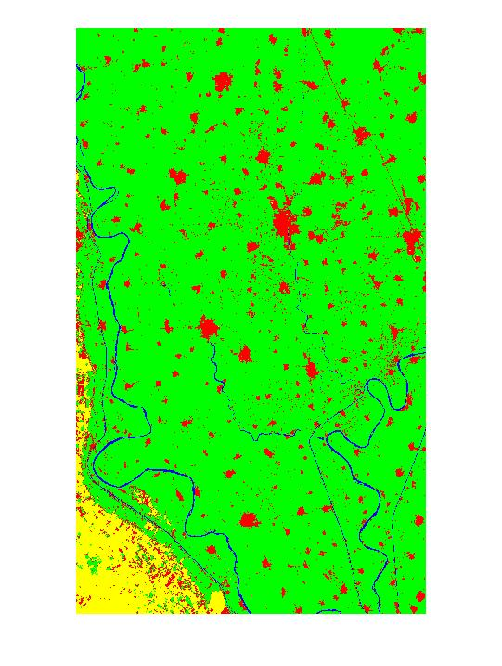
Final Results:
2003 KNN Classification

Slide 36
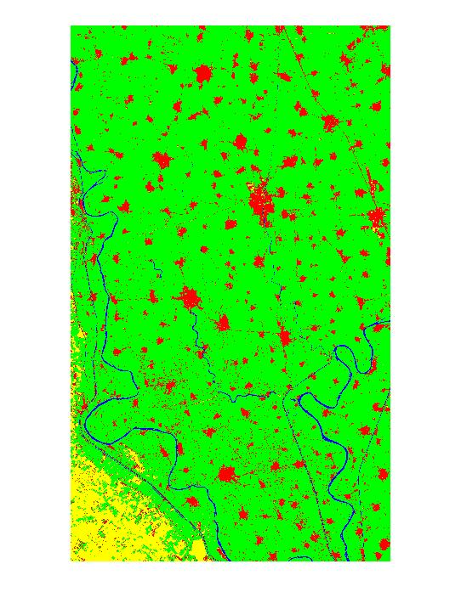
Final Results:
2015 KNN Classification
27.5931 Km^2
1.43%

Slide 37
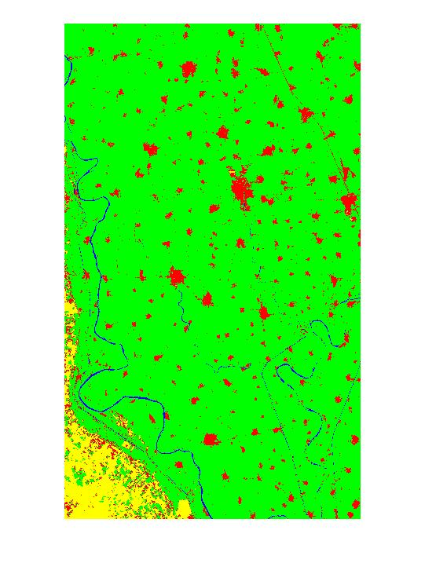
Final Results:
2003 Maximum Likelihood

Slide 38
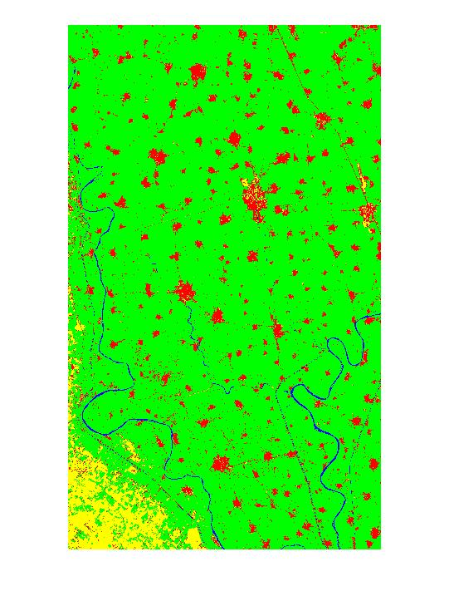
Final Results:
2015 Maximum Likelihood
31.6449 Km^2
1.65%

Slide 39

Final Results:
2003 NDVI Classification

Slide 40

Final Results:
2015 NDVI Classification
31.9428 Km^2
1.66%

Slide 41


